Slide 1
Σειρά Εργασιών 1 Short Presentation
Χουλιαράς Ανδρέας 2143
Καραμέλλιος Σωτήρης 2237

Slide 2
1.1 FIFO pipe
p0:main(){
p1: pipe_init();
p2: open(input_file,output_file);
p3: create_threads();
p4: busy_wait_threads();
p5: pipe_destroy();
p6: return 0;
p7:}

Slide 3
1.1 FIFO pipe
p0:readerThread(args){
p1: for(i=0,i<file_size,i++){
p2: read_from_file(input_file,c);
p3: while(pipe==full) nop;
p4: write_in_pipe(c);
p5: }
p6: pipe_close();
p7: return 0;
p0:writerThread(args){
p1: while(1){
p2: while(pipe == Empty ){
p3: if(pipe == closed) return;
p4: }
p5: read_from_pipe(c);
p6: write_to_file(output_file,c);
p7: }

Slide 4
1.2 Αναγνώριση πρώτων αριθμών
p0:main(threads n){
p1: allocate_space(n);
p2: thread_create(n);
p3: get_number(num);
p4: while (num !=0){
p5: while( all_threads == busy) nop;
p6: assign_work_to_worker();
p7: notify_worker_to_start();
p8: get_number(num);
p9: }
p10: notify_workers_to_terminate();
p11: busy_wait_workers_to_terminate();
p12: return 0;
p13:}
p0:worker(input){
p1: while(busy || not_terminate){
p2: if(there_is_work){
p3: prime_test();
p4: print_result();
p5: }
p6: busy = 0;
p7: }
p8: notify_main(terminating);
p9: return 0;
p10:}

Slide 5
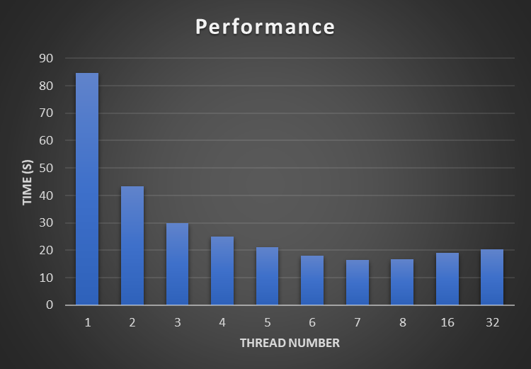
Απόδοση προγράμματος ως συνάρτηση του αριθμού των νημάτων

Slide 6
1.3 Quicksort
p0:main(){
p1: array = get_numbers();
p2: allocate_array(size);
p3: create_thread();
p4:
p5: busy_wait_thread();
p6: print_result(array);
p7: free(array);
p8: return(0);
p9:}
p0:sorting(input){
p1: if(elements > 1){
p2: quicksort_step();
p3: initialising_for_sub_arrays();
p4: thread_create(low);
p5: thread_create(high);
p6:
p7: busy_wait_threads();
p8: }
p9: notify_parent(terminating);
p10: return 0;
p11:}

